Slide 1
Bootcamp Journey
Week-5
M Kaushik
mkaushik.kaushik@team.telstra.com​

Slide 2
Topics covered
ES6 and Typescript
ReactJS
API Testing and Clean code practices
Microservices

Slide 3
ES6
What is ES6?
ES6 (ECMAScript 2015): ES6 is the sixth edition of the ECMAScript language specification, which standardizes JavaScript and introduces new features like arrow functions, classes, and template literals.
How is ES6 Better Than Previous Versions?
Enhanced Syntax and Features: ES6 improves code readability and maintainability by introducing features like let and const for block-scoped variables, and modern syntax for creating classes and modules, making JavaScript development more efficient and less error-prone.
Improved Asynchronous Programming: ES6 introduced Promises, which simplify handling asynchronous operations and errors, reducing the need for complex callback functions used in previous versions.

Slide 4
Typescript
What is TypeScript?
TypeScript(TS) is a statically typed superset of JavaScript developed by Microsoft, which compiles down to plain JavaScript, offering enhanced features for large-scale application development.
TS supports :
Classes and Objects
Static typing (optional)
data types: number, string, any, boolean, never, enum,
Allows to type code in Object oriented manner. And get it converted to JS. Supports additional features such as duck typing, inheritance, interface, function overloading.

Slide 5
ReactJS
How ReactJS is Better Than Other Front-End Frameworks/Libraries:
Component-Based Architecture: ReactJS promotes a component-based architecture, allowing developers to build reusable UI components, which leads to cleaner, more maintainable, and scalable code.
Virtual DOM: ReactJS uses a virtual DOM that optimizes updates by only re-rendering components that have changed, resulting in faster performance compared to traditional DOM manipulation.
Unidirectional Data Flow: React enforces a unidirectional data flow, making the data management more predictable and easier to debug, especially in large applications.
Asynchronous Component Loading: React supports asynchronous loading of components, enabling better performance and faster initial load times by splitting the code into smaller chunks that can be loaded on demand.

Slide 6
API Testing
Why is API Testing Required?
Ensure Functionality: API testing is required to verify that the API performs its intended functions correctly and handles all possible inputs, including edge cases.
Validate Data Integrity: It ensures that the data exchanged between different services and components via the API is accurate, consistent, and secure.
Identify Issues Early: API testing allows for early detection of issues, such as bugs or security vulnerabilities, before the application reaches the user interface (UI), reducing the cost and effort of fixing them later.

Slide 7
API Testing
Major Points to Consider for API Testing:
Error Handling
Validation of Response
Compliance with Standards (SOAP)
Security Testing
Input Parameter Testing
Performance Testing

Slide 8
Clean Code Practices
Meaningful Naming: Use clear and descriptive names for variables, functions, and classes, making the code more readable and self-explanatory.
Single Responsibility Principle (SRP): Ensure that each function or class has one purpose or responsibility, promoting modularity and making the code easier to maintain and debug.
Consistent Formatting: Maintain consistent code formatting, such as indentation, spacing, and brace placement, to improve readability and make collaboration easier.
Avoid Magic Numbers and Strings: Replace hardcoded values with named constants or enums, making the code more understandable and easier to update.
Write Small Functions: Break down complex tasks into smaller, focused functions, each doing one thing well, to enhance readability, testing, and reusability.

Slide 9
Microservices
How Microservices Are Better Compared to Monolithic Architecture:
Scalability: Microservices allow independent scaling of components, unlike monoliths which require scaling the entire application.
Technology Flexibility: Microservices enable the use of diverse technologies for different services, while monoliths are limited to a single tech stack.
Fault Isolation: Microservices isolate failures to individual services, preventing system-wide crashes, unlike monoliths where one failure can affect the whole system.
Faster Deployment: Microservices enable quicker, independent development and deployment, whereas monolithic applications require redeploying the entire system for changes.
Easier Maintenance: Microservices allow updates and maintenance without affecting the whole system, while monoliths require redeploying the entire application.

Slide 10
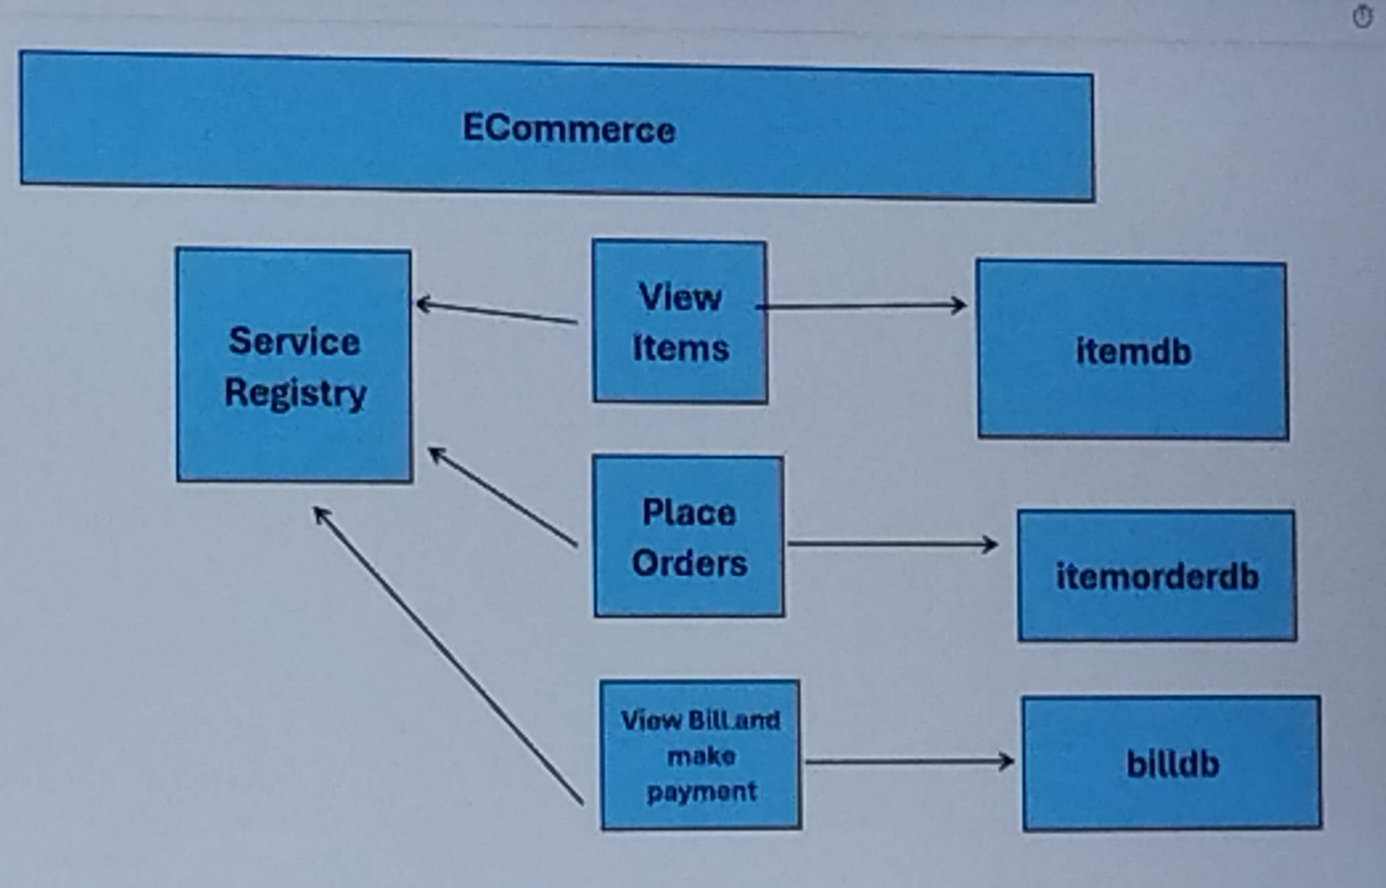
Microservice Implementation
Figure: Microservice implemented using Prisma

Slide 11
Thank you

